Slide 1
Romanian - Norwegian Strategic Cooperation in Maritime Higher Education for enhancement human capital and knowledge base in field of marine intelligent technologies
ANMB
Acronym: MARINTECH

Slide 2
A5 Online meeting. Closure meeting
ANMB
Acronym: MARINTECH

Slide 3
Information PROJECT
Project start date: Sep 2021
Project end date: Aug 2023
Applicant institution: Academia Navală „ Mircea cel Bătrân” Constanța
Partner: Norges teknisk-naturvitenskapelige universitet / NTNU Ålesund
Total budget: 162.393,00 EUR
Funded under the EEA Grants - Financial Mechanism 2014-2021
THE EDUCATION, SCHOLARSHIPS, APPRENTICESHIPS AND YOUTH ENTREPRENEURSHIP PROGRAMME (ESAYEP), 2014-2021

Slide 4
PROJECT IMPLEMENTATION FIELD
Fields of marine engineering training human capital within the project:
Robotics in the maritime industry;
Machine learning in the maritime industry;
Oceanography and Hydrography

Slide 5
WHAT ARE THE TARGET GROUPS OF THE PROJECT?
The target group for the development of human capital in the field of intelligent marine technologies
- the students of the master's studies of both partner universities;
- the academic staff of both partner universities.
Fields of activity on the labor market benefiting from the training of human capital in the use of intelligent marine technologies:
- the port industry, the exploitation of marine resources, biomarine research, marine universities, the defense system, etc.

Slide 6
THE DIRECTIONS OF ACTION of the project
The enhancement of the quality and relevance of education and training
Higher education student and staff learning mobility between donor-DS and beneficiary countries – BC
Cooperation and partnerships between education and the world of work
Professional development of teachers

Slide 7
THE MAIN objectives of the project
The general objectives of the project to achieve these directions of action are:
supporting the development of human capital (students, academic staff) in both universities with a strong interdisciplinary component on marine intelligent technologies;
modernization of partner universities;
ensuring a closer relationship between the educational offer and the labor market.

Slide 8
Project activities
A. PROJECT MANAGEMENT AND IMPLEMENTATION ACTIVITIES
O. INTELLECTUAL OUTPUTS/ACTIVITIES
M. MULTIPLIER EVENTS
C. LEARNING/TEACHING/TRAINING ACTIVITIES

Slide 9
O. INTELLECTUAL OUTPUTS/ACTIVITIES
O1: “Innovative common curriculum for course modules on marine intelligent technologies: „Intelligent technologies applications in maritime industry"
Sept. 2021
Aug. 2022
O2: “Virtual training platform on robotics and marine intelligent technologies”
Sept. 2021
July 2023
O5: "Dissemination: joint research papers"
Sept. 2021
Aug. 2023

Slide 10
O. INTELLECTUAL OUTPUTS
O1: “Innovative common curriculum for course modules on marine intelligent technologies: „Intelligent technologies applications in maritime industry„
The course modules:
NTNU - "Practical applications in marine robotics" - 28 hours/semester (course-14 hours + laboratory-14 hours) - 4 ECTS;
MBNA - "Applications of intelligent technologies in bathymetry and oceanography"-28 hours/semester (course-14 hours + laboratory -14 hours) - 4 ECTS;
NTNU - "Machine learning applications in maritime industry" -28 hours/semester (course-14 hours + laboratory-14 hours) - 4 ECTS.

Slide 11
Program of the course:
„Intelligent technologies applications in maritime industry"
in the first week of April 2023 - physical mobility - NTNU:
- "Practical applications in marine robotics" module: 6 hours lecture + 14 hours laboratory;
- "Machine learning applications in the maritime industry" module: 6 hours lecture + 14 hours laboratory;
in the second week of April 2023 - virtual mobility (via VTP)
- "Practical applications in marine robotics" module: 8 hours lecture
- "Machine learning applications in the maritime industry" module: 8 hours lecture.
in the first week of May 2023 - physical mobility – MBNA
- "Applications of intelligent technologies in bathymetry and oceanography„ module: 14 hours lecture + 14 hours laboratory;
in the third week of May 2023 - the evaluation of students - in the virtual environment, based on a grid questionnaire, jointly developed by both partners, via VTP- platform.

Slide 12
O. INTELLECTUAL OUTPUTS
O2: “Virtual training platform on robotics and marine intelligent technologies”
1 virtual advanced distributed learning platform for sharing the course content to the students for specific course developed in O1 (course materials, video-tutorial, digital resources);
1 virtual collaborative e-campus for teachers and researchers, where the academics to be connected peer-to-peer with their colleagues in the partner campuses, by forum dialogue, sharing the teaching practices results in the marine intelligent technologies area of knowledge;
1 virtual e-section dedicated to promoting the infrastructure facilities where each partner will be able to provide information about the own didactic infrastructure and the conditions under which laboratories and infrastructure could be available for interested persons/researching groups, among the partners.

Slide 13
Virtual training platform https://marintech.anmb.ro/

Slide 14
O. INTELLECTUAL OUTPUTS
O5: "Dissemination: joint research papers"
setting up a dedicated project webpage.
a minimum of 2 joint articles to peer-reviewed journals.
The topics of the articles:
- applications of intelligent technologies in the field of the maritime industry,
- digital and innovative teaching/learning/assessment methods applicable in the field of marine intelligent technologies, methods implemented and evaluated within the project.
the articles in newspapers, magazines, press releases and conferences.

Slide 15
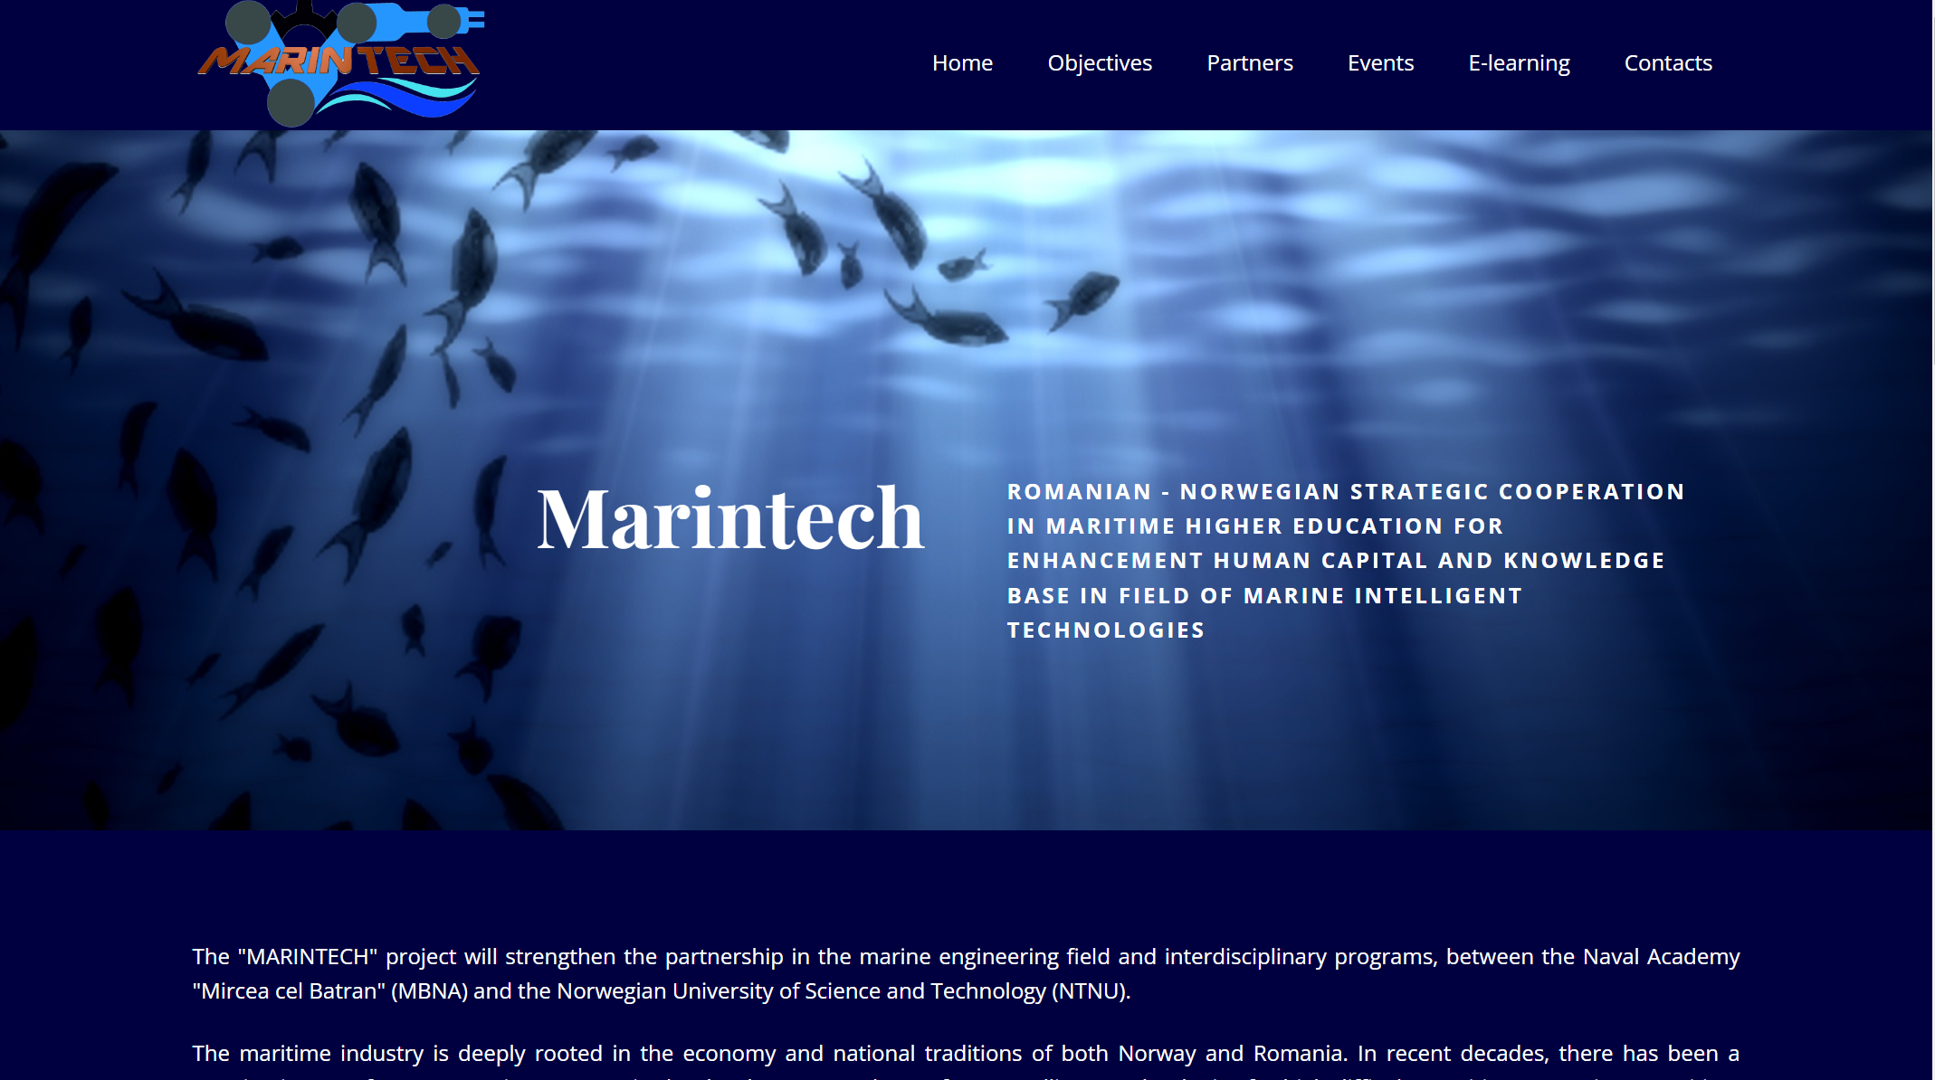
Project webpage https://www.anmb.ro/marintech/

Slide 16
C. LEARNING/TEACHING/TRAINING ACTIVITIES
The purpose of these activities:
to improve the innovative learning/teaching practices and tools in the marine intelligent technologies area;
to allow students and teachers to work together in multinational and multidisciplinary groups;
to allow exchanges of experiences and good practices on teaching methods, content, and new curricular approaches between academic staff,
to test innovative teaching methods that will be applied in the course modules of intelligent technologies applications in the maritime industry;
to provide knowledge and skills to facilitate the enhancement of the graduates' insertion into the labor market.

Slide 17
ANMB
Thank you for the good collaboration during the 2 years.
We hope for a future collaboration.

